Slide 1


Sharing Clinical Quality Language (CQL) Libraries for CMS program measures
October 28, 2021

Slide 2

Objectives
Background
Review potential eCQI Resource Center mock-up
Gather information on implementer use cases
Discuss next steps
2

Slide 3
CQL Libraries Background
CQL libraries are packages of logical expressions in CQL-based eCQMs.
There are common libraries currently being used across eCQMs by measure developers such as:
MAT Global Common Library
Frailty library
Hospice library
These libraries are defined and available in the Measure Authoring Tool (MAT) but are not readily available for sharing with implementers as individual artifacts
3
Notes:
Additionally, we should emphasize that this discussion is specific to QDM based measures

Slide 4
Information Gathering
The purpose of this discussion is to understand if there is value in pursuing a repository to enable sharing these libraries outside of the current processes for QDM based eCQMs.
Review a possible solution in the slides following
Collect real time responses to questions
4
Notes:
Additionally, we should emphasize that this discussion is specific to QDM based measures

Slide 5
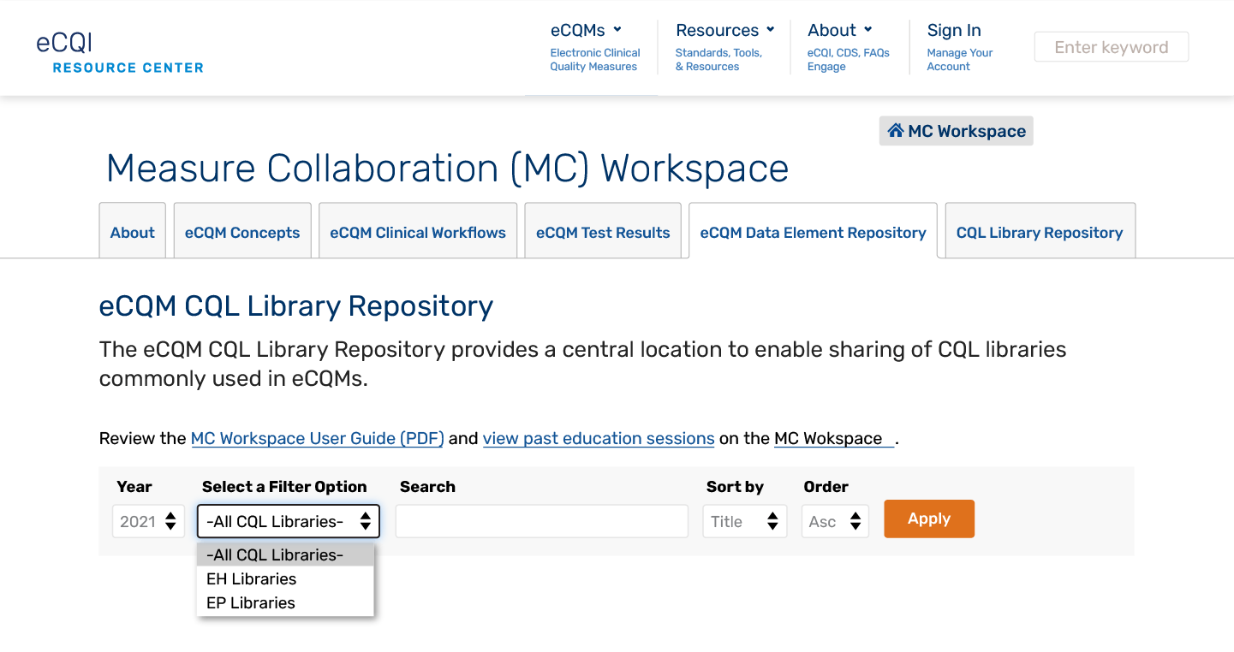
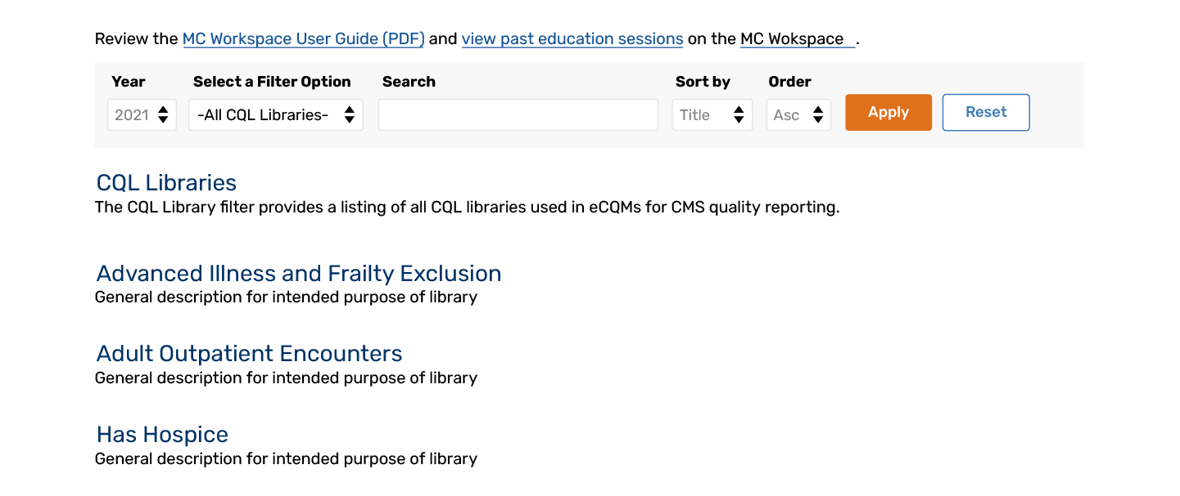
CQL Library Sharing for QDM Based eCQMs- Examples
5

Slide 6
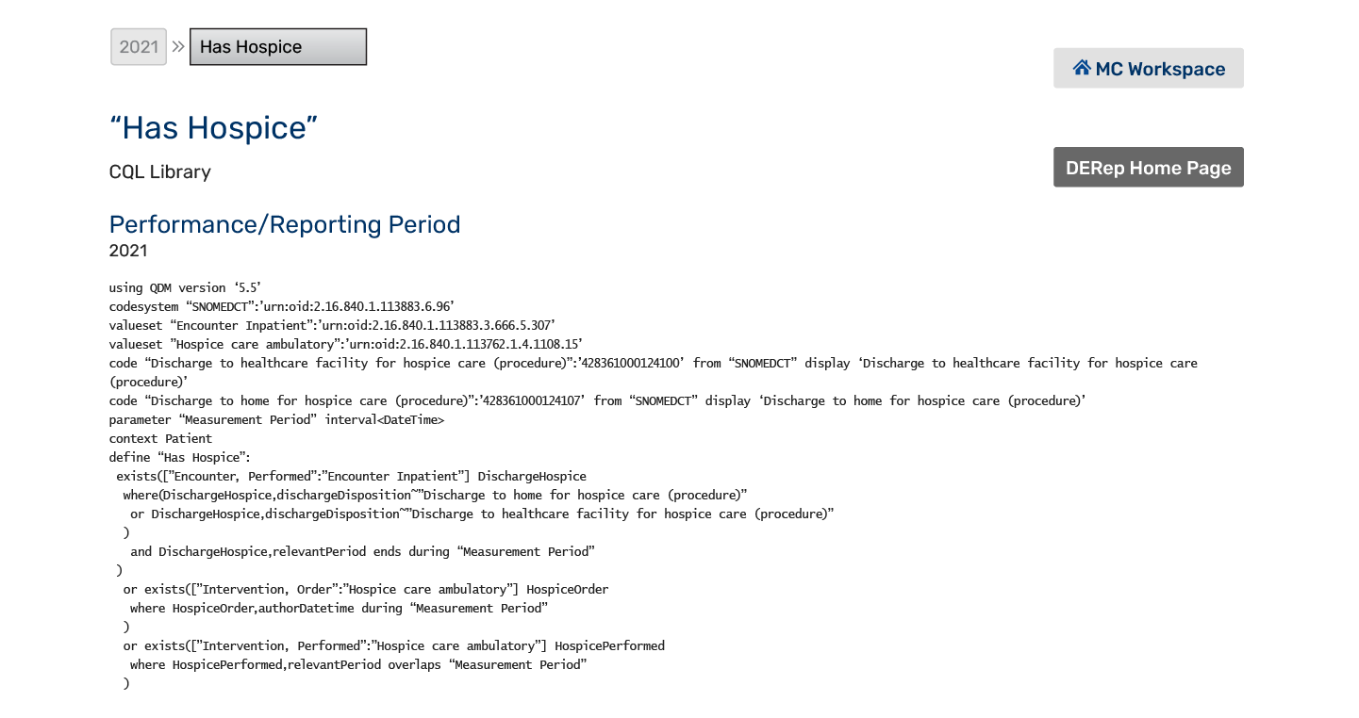
CQL Library Sharing for QDM Based eCQMs- Examples cont’d
6

Slide 7
CQL Library Sharing – Question 1
Would the ability to see libraries shared across multiple program measures be useful to implementers?
Why or why not?
7
Notes:
For example, the MAT Global Common library is used across almost every CMS program eCQM. Would it be helpful to implementers to see the contents of this library without logging into the MAT or a measure zip file?
Does your system currently consume eCQM CQL directly?
Does your system currently consume eCQM ELM directly?
Does your system currently consume individual CQL definitions directly?
Does your system currently consume individual ELM definitions directly?
Would you utilize individual CQL resource definitions if published outside of eCQM packages?

Slide 8
CQL Library Sharing – Question 2
Do you currently access shared libraries from the Measure Authoring Tool or from discrete measure packages?
8
Notes:
If implementers are accessing these files on their own and performing a compare internally, they may be already meeting the needs

Slide 9
CQL Library Sharing – Question 3
Are you isolating CQL libraries for secondary use inside and outside of measure calculation?
9

Slide 10
CQL Library Sharing – Question 4
Would other information about the libraries be useful in addition to posting their content:
Changes to the library from year to year
Changes in setting
Additional documentation like evidence or guidelines
Rationale for the logic approach
10
Notes:
Are there aspects of the way that measures and/or libraries are currently developed and distributed that are barriers to reuse of the expression logic? For example, temporal constraints, implied context, or other constraints?

Slide 11
Next Steps
Determine additional use cases for establishing CQL library sharing
Determine where on the eCQI resource center CQL library sharing should be established
11

Slide 12
Evolution of eCQM Standards
Current
Emerging
eCQM Specifications
eCQM Specifications
QDM Data Model
CQL Logic
HQMF eCQM
QI-Core Profiles
CQL Logic
Quality Measure IG
eCQM Reporting
eCQM Reporting
QDM Data Model
QRDA I
QRDA III
QI-Core Profiles
DEQM Individual
Report
DEQM Summary
Report
QDM – Quality Data Model | CQL – Clinical Quality Language | HQMF – Health Quality Measure Format | QRDA – Quality Reporting Document Architecture | QI-Core – Quality Improvement Core | DEQM – Data Exchange for Quality Measures
12

